Slide 1
Machine Learning Analysis of Mortality Rates in Northern India
Understanding Crude Death Rates and Gender Disparities
Presented by: Ucheoma Udoha

Slide 2
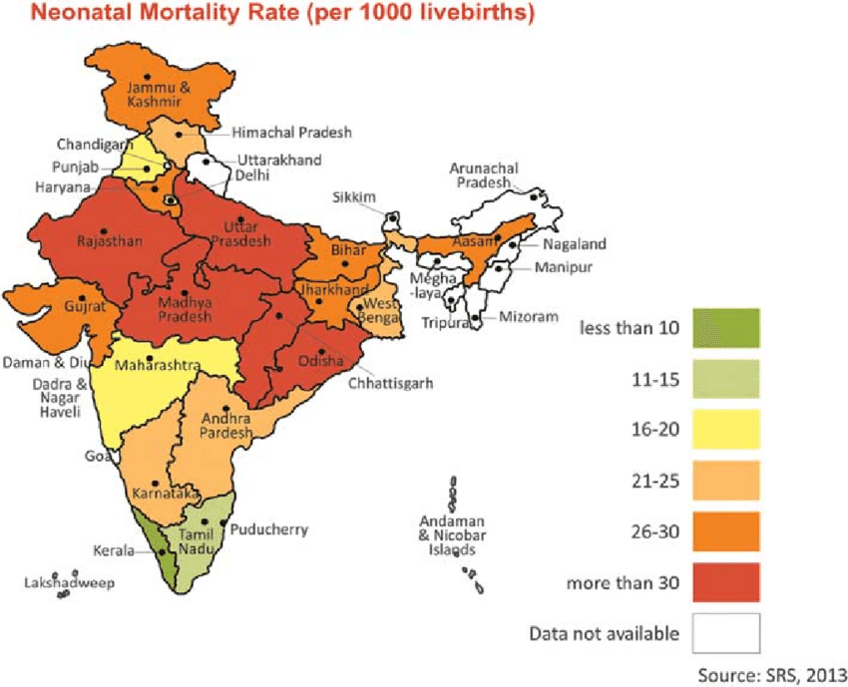
Introduction
It’s Important to understand mortality rates in healthcare.
Objectives: Analyze mortality data to identify trends across states in northern India.
Focus on gender disparities and state-wise variations.

Slide 3
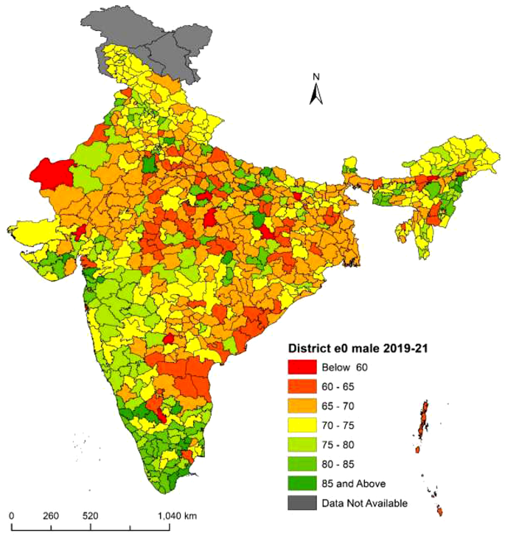
Problem Statement
The hospital wants to identify high-mortality states in northern India.
Determine if the crude death rate is higher among males or females.
Provide actionable insights for resource allocation and public health interventions.

Slide 4
Data Collection
Data source: 'YY_Mortality_District.csv'
Key columns: Crude death rates for males, females, and total persons; infant mortality rates; state names.
Data covers districts across northern India.

Slide 5
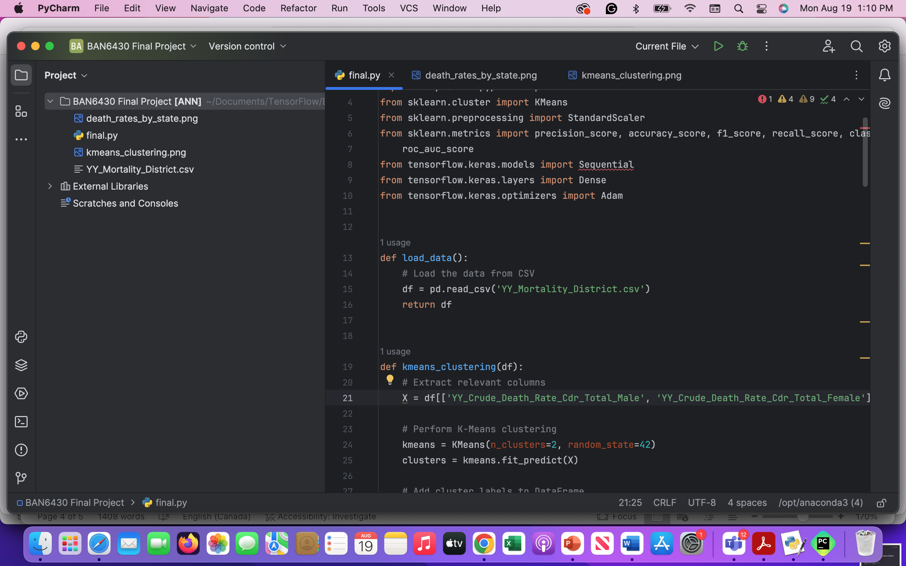
Data Cleaning and Preprocessing
Handling missing values - Removed rows or imputed missing values.
Feature selection - Focused on relevant features for mortality analysis.
Data transformation - Normalized or standardized crude death rates.

Slide 6
Exploratory Data Analysis (EDA)
Understand patterns and relationships within the dataset.
Focus on gender-based and state-wise mortality analysis.
Visualization techniques like bar charts for state-wise comparison.
Correlation analysis to identify potential predictors.

Slide 7
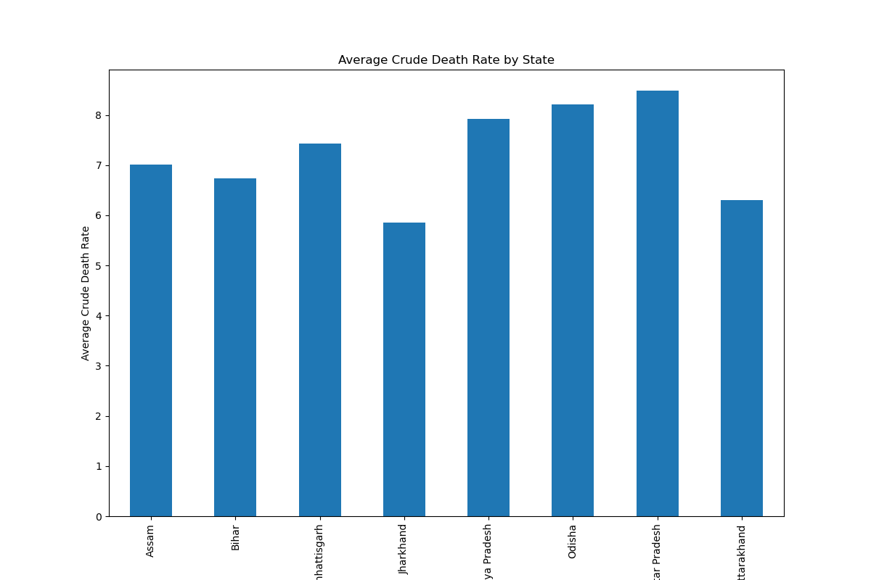
State-Wise Mortality Rates

Slide 8
Gender-Based Mortality Disparities
Analyzed crude death rates for males and females.
Identified if there is a significant difference in mortality between genders.
Used both statistical analysis and visual comparisons using K-Means.

Slide 9
K-Means Clustering
Group districts based on crude death rates for males and females.
01
Identify clusters with similar mortality patterns.
02
Two clusters identified: Low mortality (yellow) and high mortality (purple).
03

Slide 10
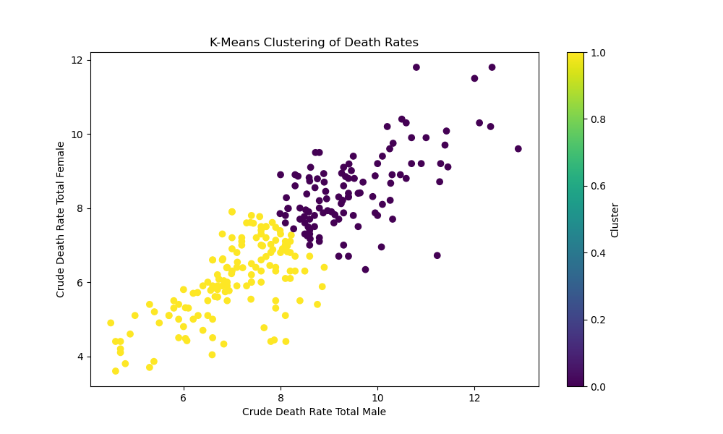
K-Means Clustering Results

Slide 11
Building and Evaluating ANN
Classified states based on whether their crude death rate is above or below the median.
Used of Artificial Neural Network (ANN) for classification.
Code: ANN model architecture with ReLU activation and binary cross - entropy loss.

Slide 12
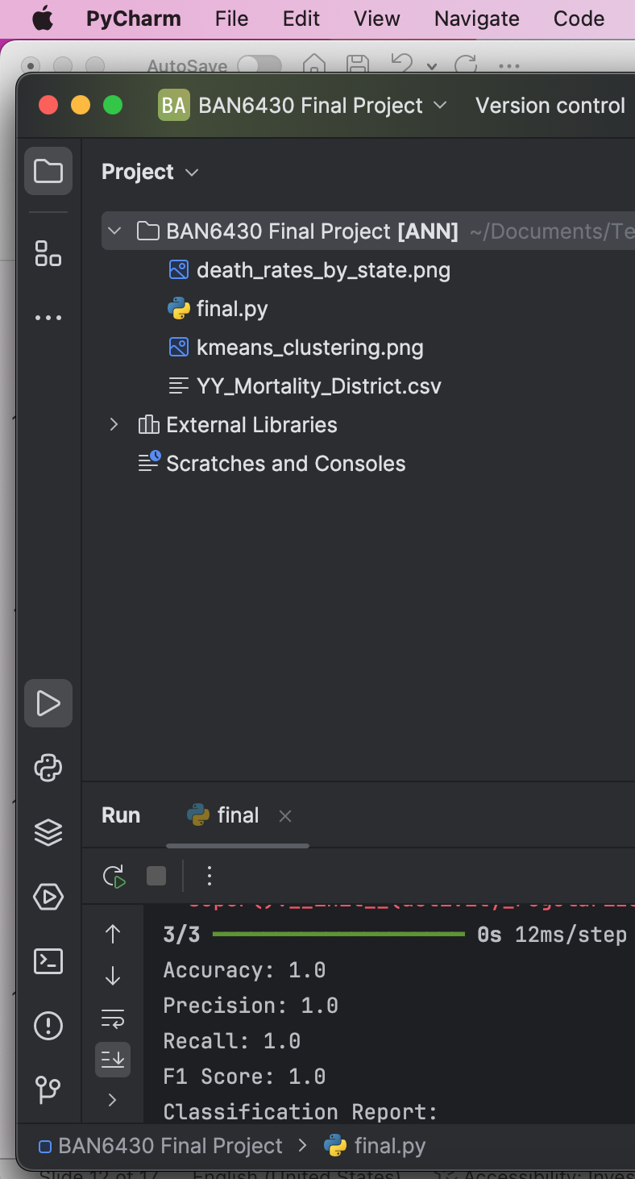
ANN Model Evaluation
Metrics Used: Accuracy, precision, recall, F1 score, and ROC AUC score.
Results: 100% accuracy, precision, recall, F1 score, and ROC AUC.
Insight: High predictive accuracy reinforces the model's reliability.

Slide 13
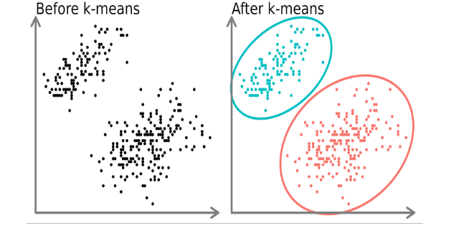
Clustering and Dimensionality Reduction
The dataset had a manageable number of features, hence didn’t use dimension reduction in clustering like PCA.
In future, PCA could be applied if more features are added for better visualization.

Slide 14
Results Interpretation
Gender-based disparities: Males have higher mortality rates in some states as represented by the K-Means result.
State-wise differences: States like Odisha and Uttar Pradesh have higher mortality rates.
The ANN model identifies high-risk states.

Slide 15
Future Recommendations
To provide targeted Interventions there is a need to focus on high-risk states and districts identified through clustering and ANN models.
Hospitals should allocate healthcare resources more effectively based on state-wise and gender-specific findings.
It may be important to incorporate more features for refined insights and predictions.

Slide 16
Conclusion
The analysis provides actionable insights into mortality trends across northern India.
The hospital can use these findings to improve patient outcomes and allocate resources more effectively.
The combination of clustering and ANN models offers a comprehensive approach to understanding mortality patterns.

Slide 17
THANK YOU

